Slide 1
Crimes against women - India
Submitted to Mr. RAMA KRISHNA K

Slide 2
Team:
SMITHA REDDY S – 20191CCE0061
SOHAN NARAYAN MOGER – 20191CCE0063
SONTI RUTHVIK SREE RANGA – 20191CCE0064
T LIKHITHA – 20191CCE0074
VEERA VAMSHI M E – 20191CCE0080

Slide 3
Violence against women:
According to scroll.in, 26 crimes against women are reported every hour or one complaint every two minutes.
Studies from different countries show that the percentage of women 15 to 49 years old who've experienced physical and/or sexual violence in their lifetime ranges from 15% to 71%.
Globally 81,000 women and girls were killed in 2020, around 47,000 of them (58%) died at the hands of an intimate partner or a family member.
As per the data in 2021, a total of 4,28,278 cases of crime against women were registered in India alone.

Slide 4
Objective:
Our main objective is to throw light on the crimes against women in India with the help of graphs and to analyze which crime is highly reported. To show how crimes against women were increasing from 2001 to 2014 and also to provide insights on which state is safe for women to visit/travel.
Specific objective includes,
Find the State/UT with the highest and lowest crime rate.

Slide 5
Types of crimes includes:
Female foeticide
Gender discrimination
Domestic violence
Dowry
Child marriages
Sexual offence
a. Rape
b. Molestation
c. Trafficking
d. Kidnappings, etc.

Slide 6
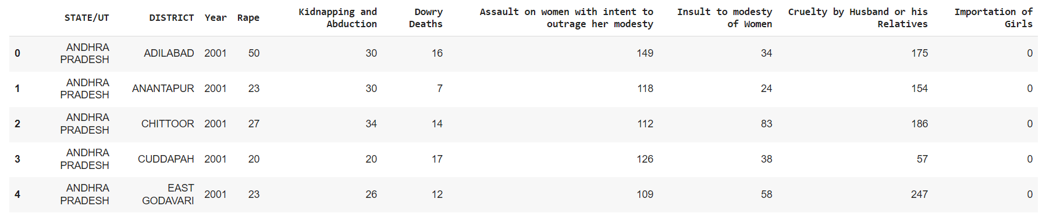
The Dataset has state-wise and district level data on the various crimes committed against women between 2001 to 2014. Some crimes that are included are Rape, Kidnapping and Abduction, Dowry Deaths etc.
Dataset

Slide 7

Libraries used:
Pandas
Plotly.express
Plotly.graph_objects
Opendatasets

Slide 8
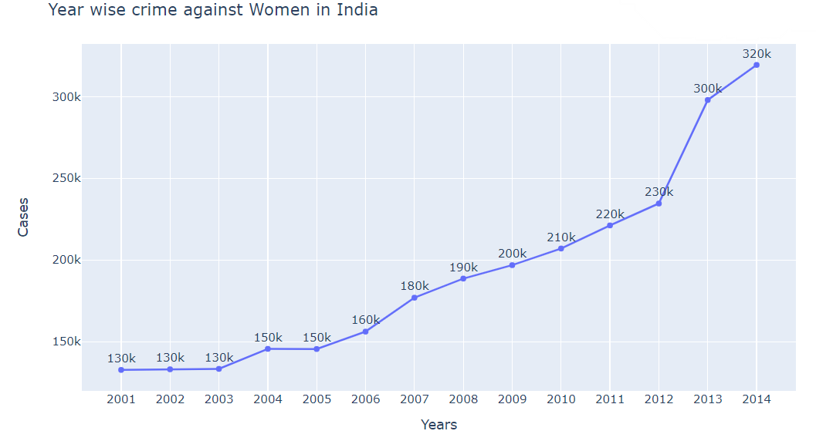
Year wise crime visualization :

Slide 9
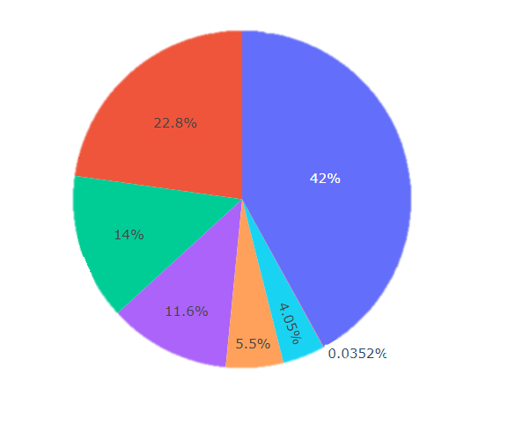

Crime rates in Percentage(%):

Slide 10
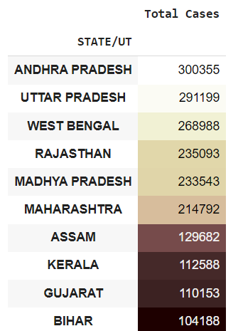
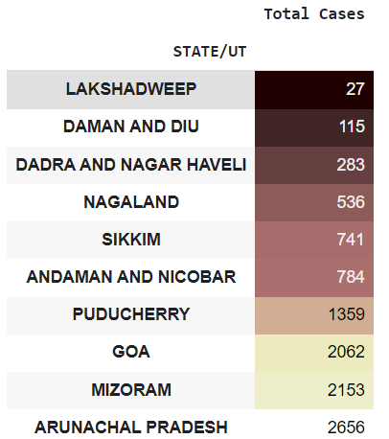
Insights:
1. Top 10 states with highest and lowest crime rate.

Slide 11
Andhra Pradesh had registered the most crimes against women from 2001 to 2014.
Madhya Pradesh reported the most number of Rape cases and Assault on her modest cases.
Uttar Pradesh reported the most number of Kidnapping and Abduction and Dowry Deaths.
Madhya Pradesh, Andhra Pradesh, Uttar Pradesh, Rajasthan and West Bengal account for almost half of all crimes committed against women around the country from 2001 to 2014.
We can find that except trafficking, all other crimes are increasing each year.
Finally the highest and lowest crime rates are found in Andhra Pradesh and Nagaland in States and Delhi and Lakshadweep in Union Territory respectively.

Slide 12
Thank you!
“Violence against women in all its forms is a human rights violation. Its not something that any culture, religion or tradition propagates.”
-Michelle Bachelet

